Slide 1


Bank System [Server-Client]
Implementing a Secure and Efficient Bank System Server-Client Model with Qt Sockets for Communication

Slide 2
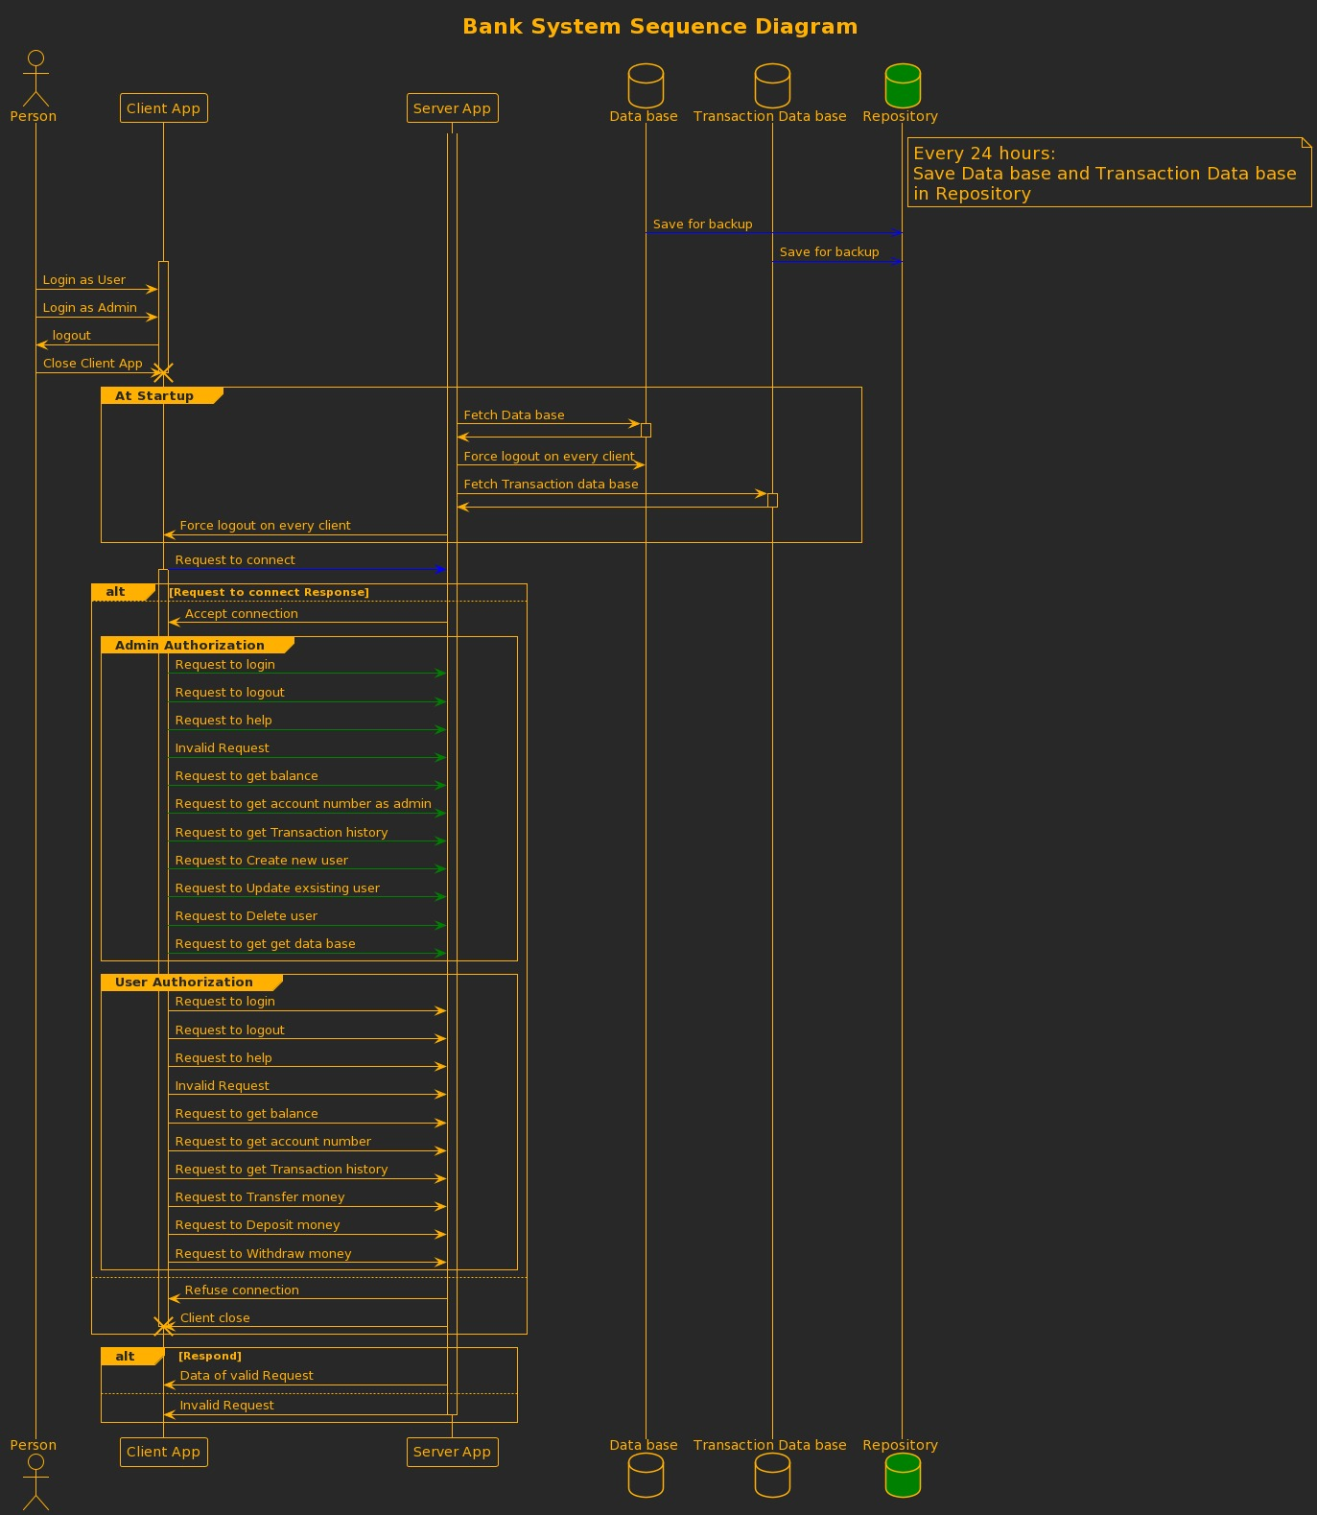
Sequence diagram for the whole system

Slide 3
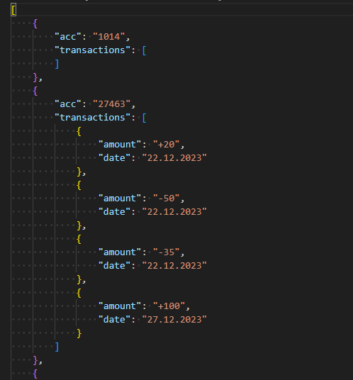
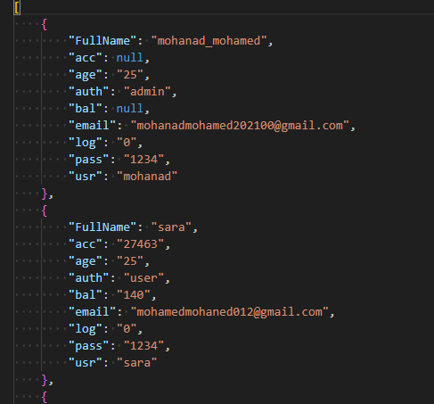
Data Base
Data Base in Json format to ensure simple read and write to the file

Slide 4
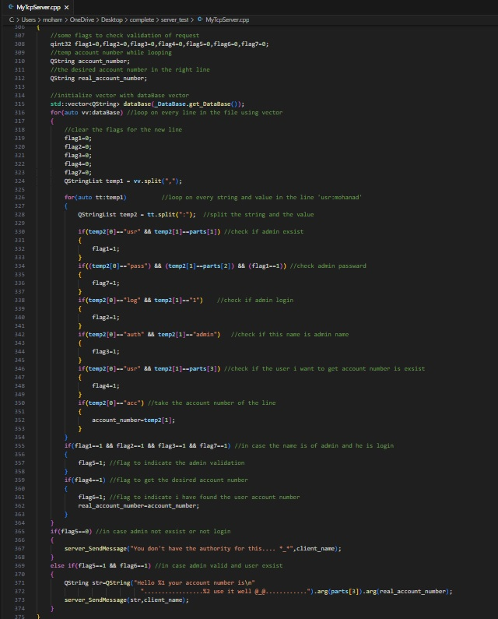
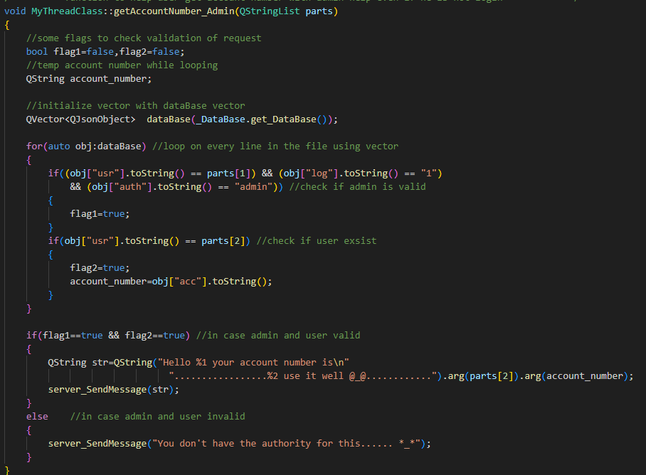

Effect of Json format
After using Json

Slide 5
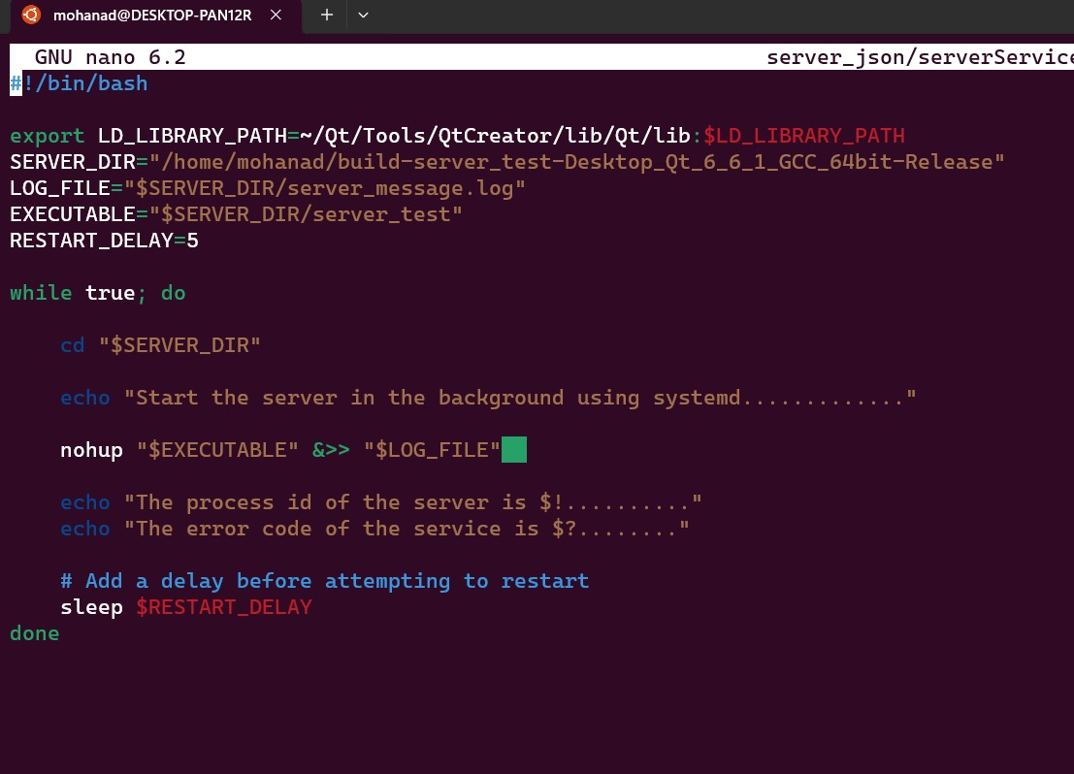
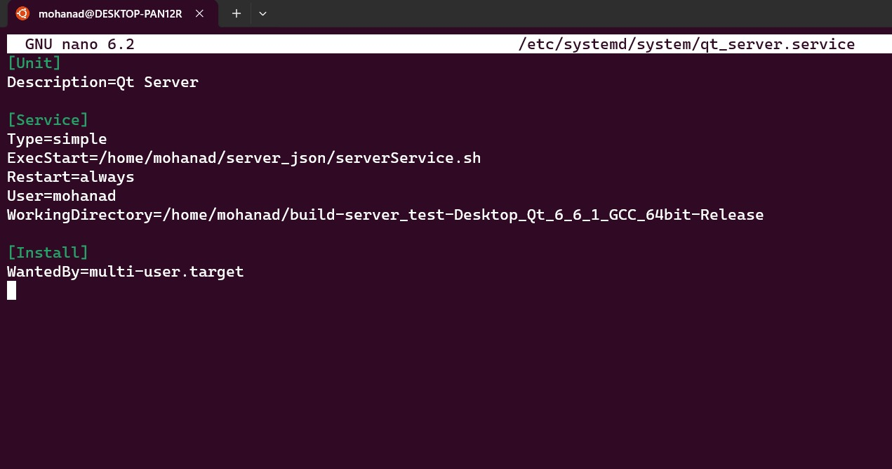
Information Security
Availability :-
Achieved through connecting server process to systemd.

Slide 6
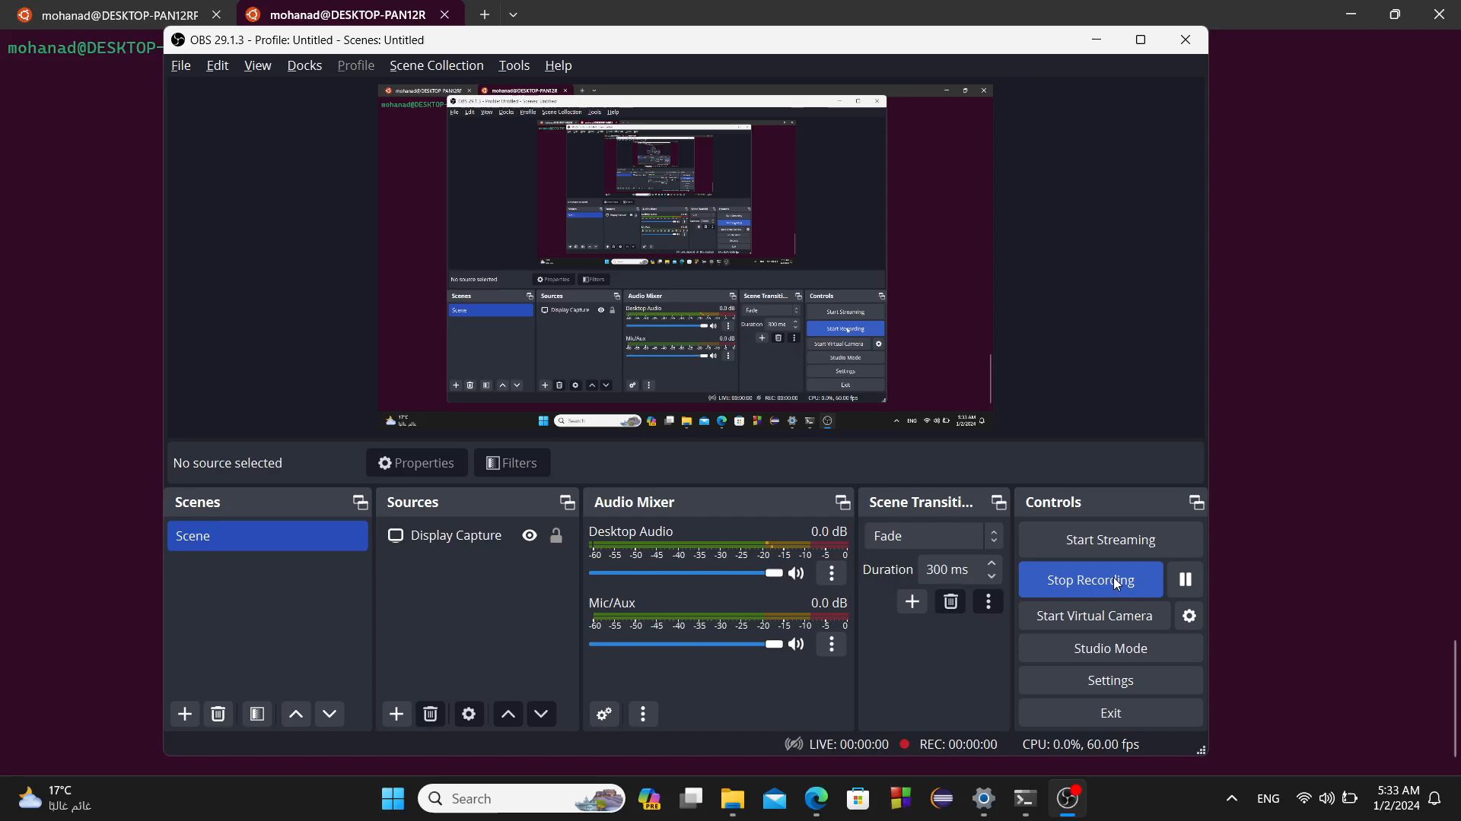

Slide 7
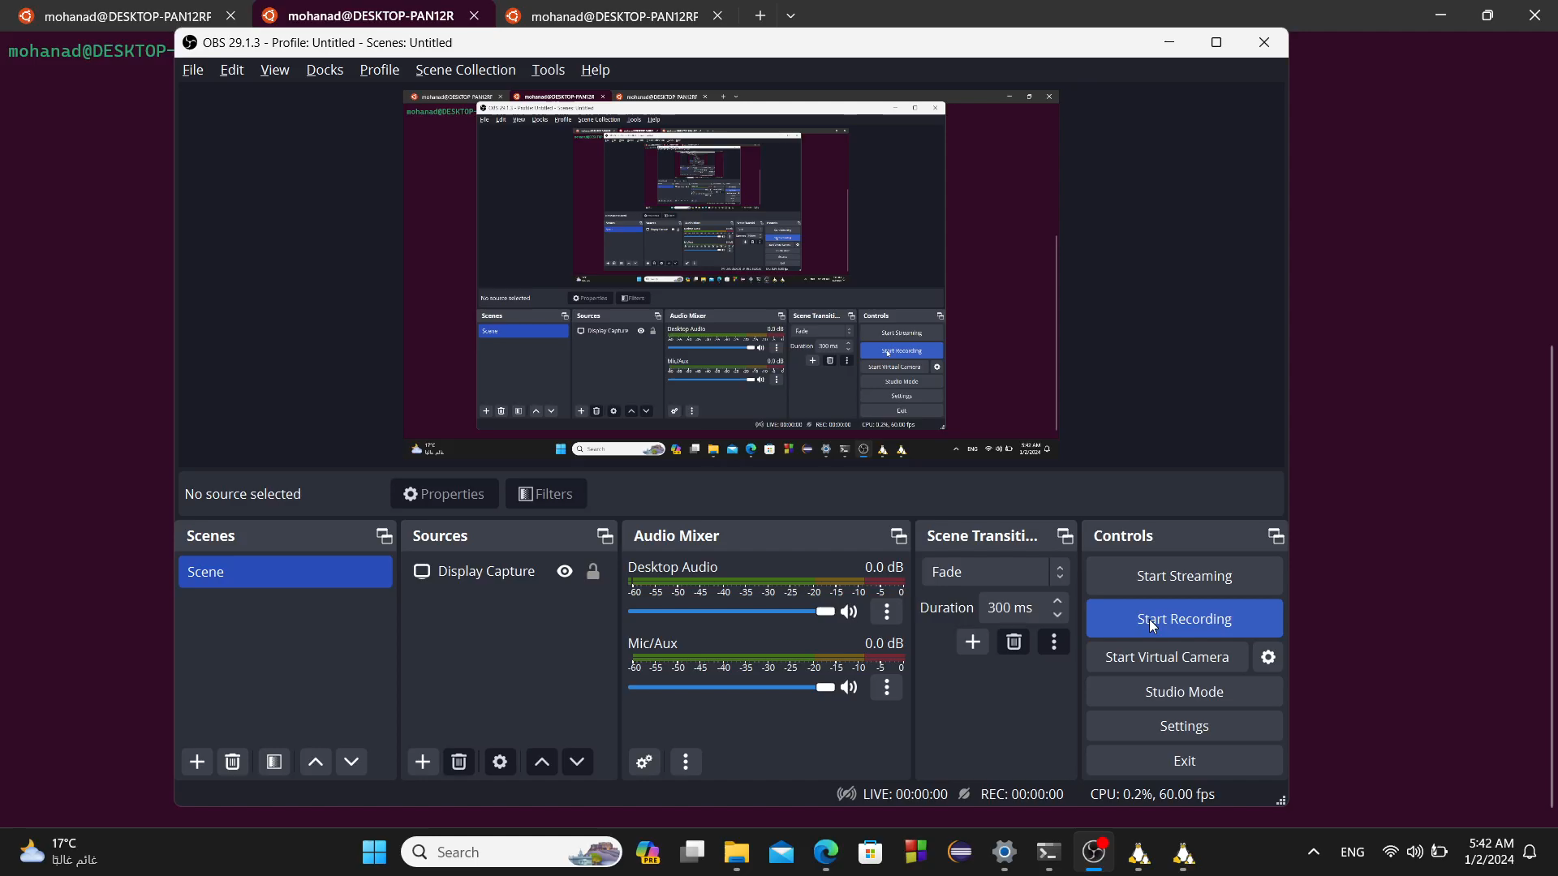

Slide 8
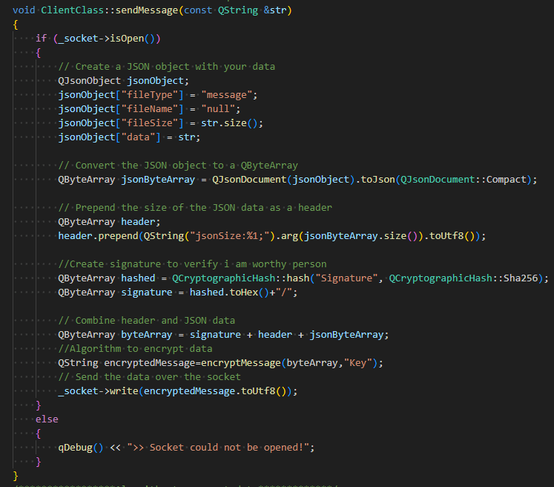
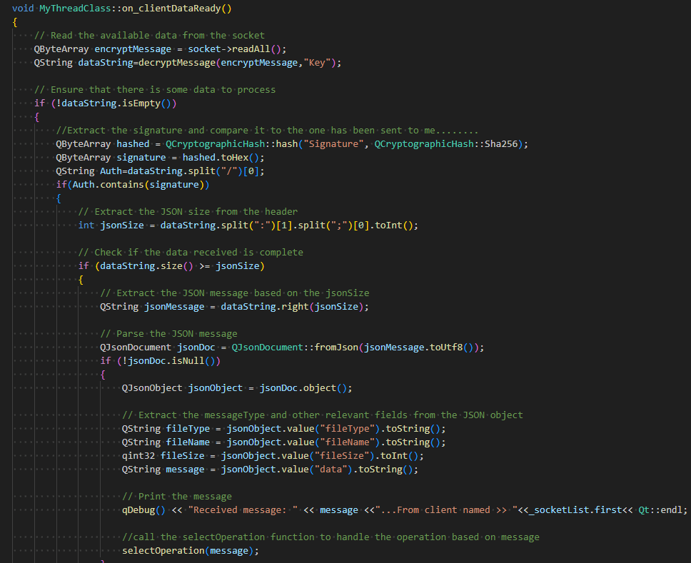
Data Integrity:-
Using TCP protocol.
Prepend MSG with header to indicate size of QByteArray.
Add a key of MSG size to the QJsonObject before sending the MSG.
Authentication
Achieved by using common MSG_ID between client and server then Hash it.
Server will do the same then compares its output with the received MSG.
"f1a73e2204a114077f988c9da98d7f8b604ab250496f25aeb3cbd153f5369c83/jsonSize:84;{\"data\":\"usrpass:mohanad:1234\",\"fileName\":\"null\",\"fileSize\":20,\"fileType\":\"message\"}"

Slide 9
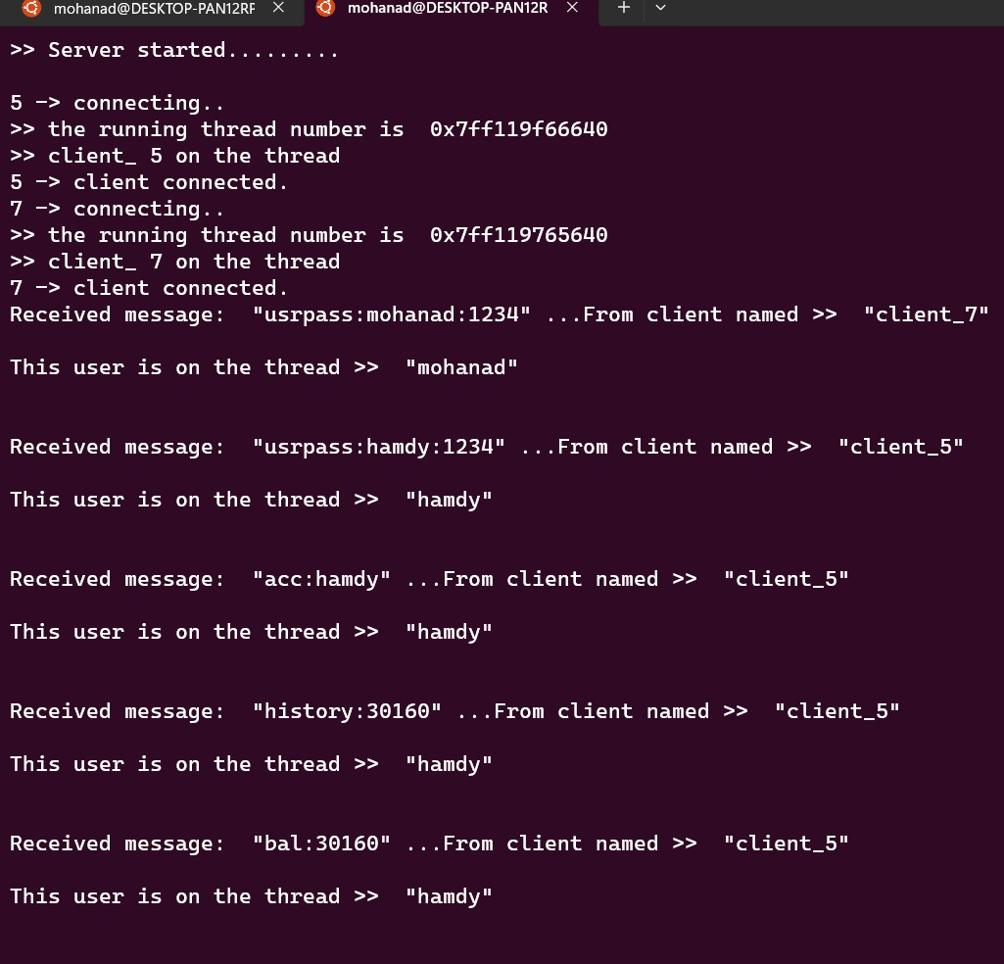
Non-repudiation:-
Server save every MSG he gets from every specific client
Monitor the file.log I have directed the output to.

Slide 10
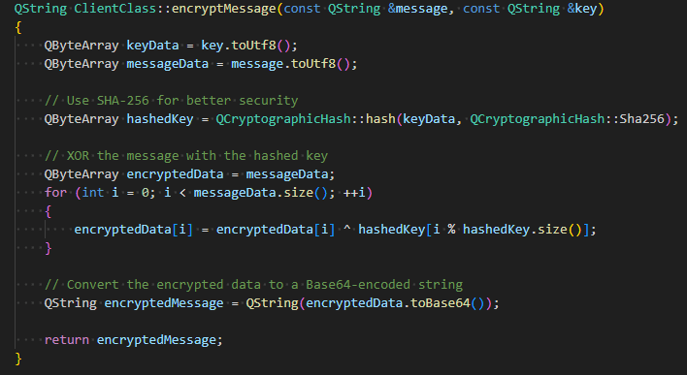
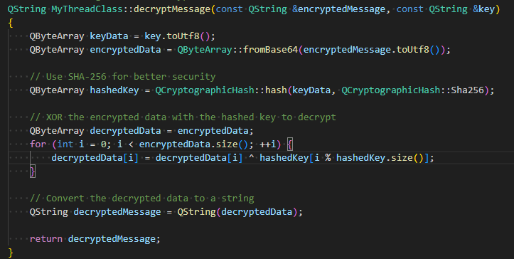
Confidentiality
Using asymmetric key with simple algorism to encrypt and decrypt message
Server and client must have the same key.
Passing key to Hash function to generate more complex key.

Slide 11
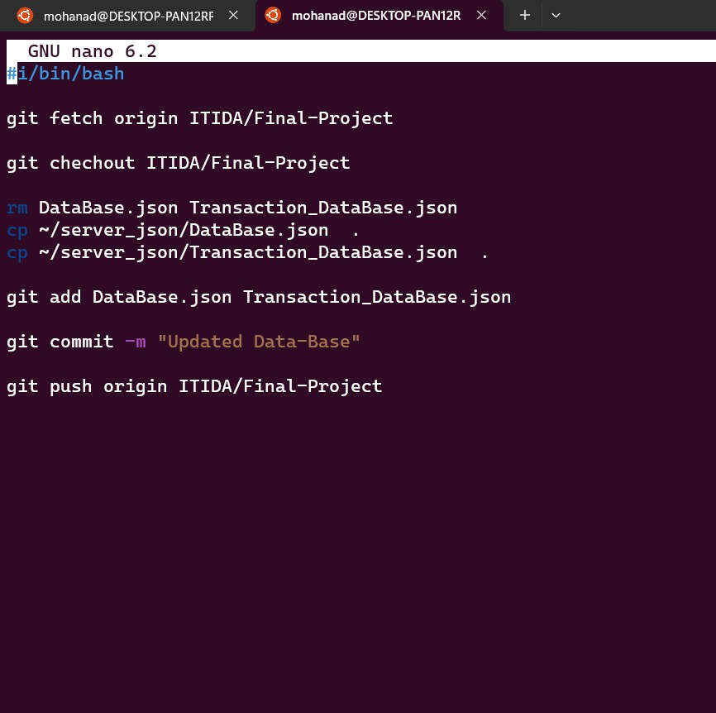
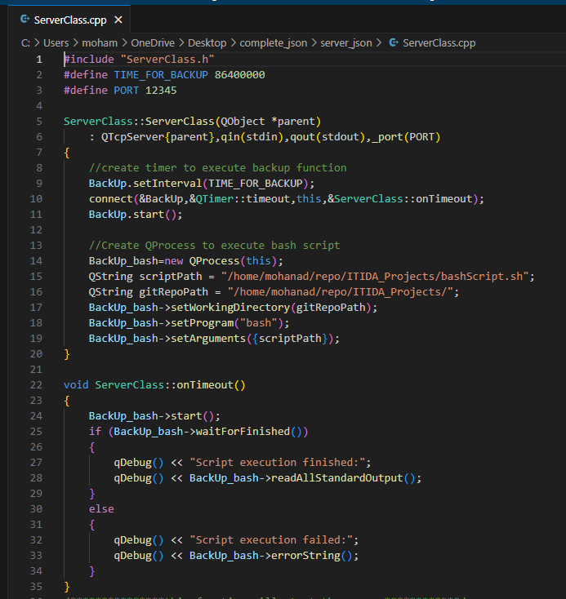
Backup
Using QTimer and QProcess to push the data base and transaction data base to repository every 24hr through bash script

Slide 12
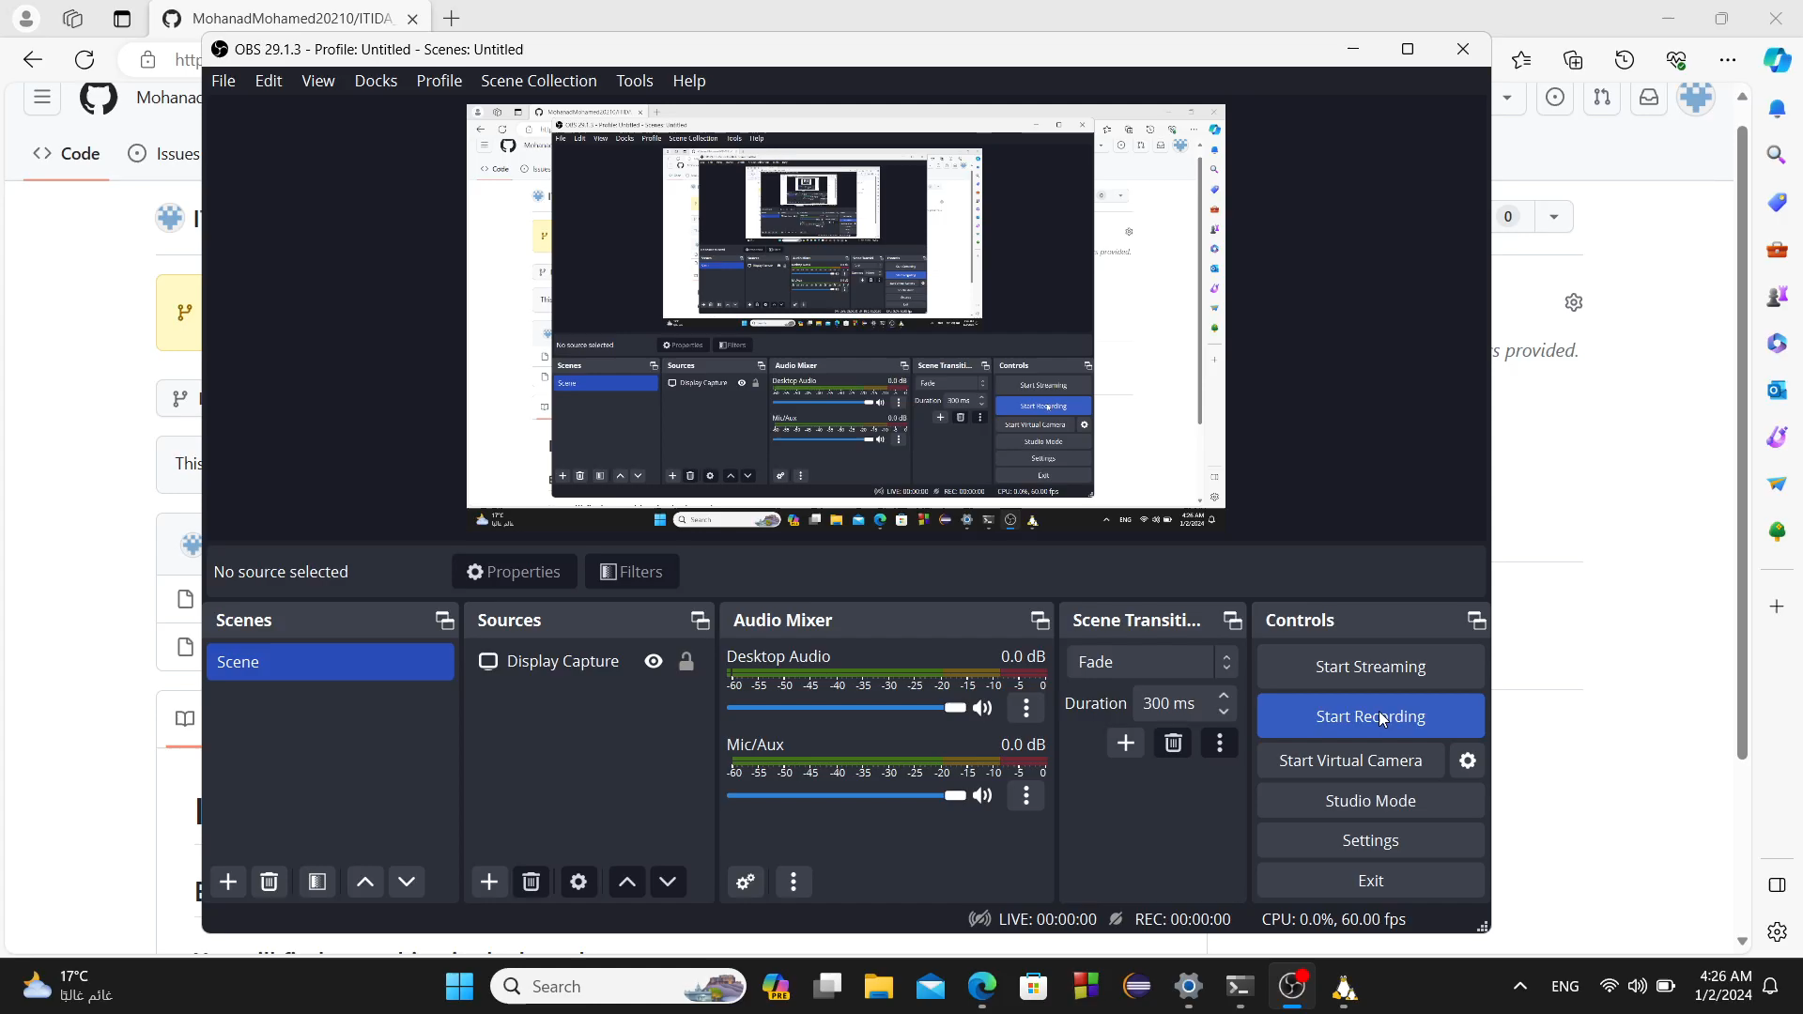

Slide 13
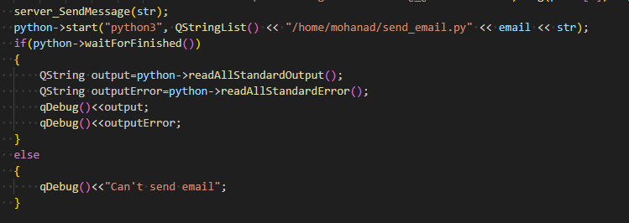
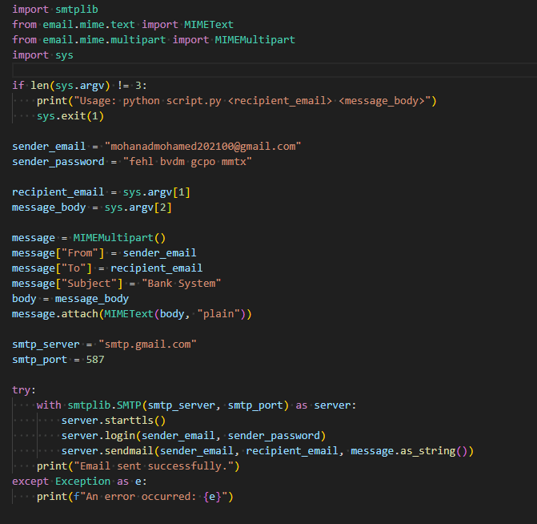
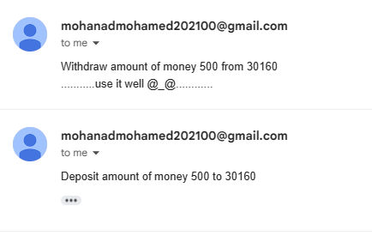
Transaction Notification Feature

